Slide 1
Movie Money Maker
Data Science Technical Assessment
Process & Architecture Walkthrough

Slide 2
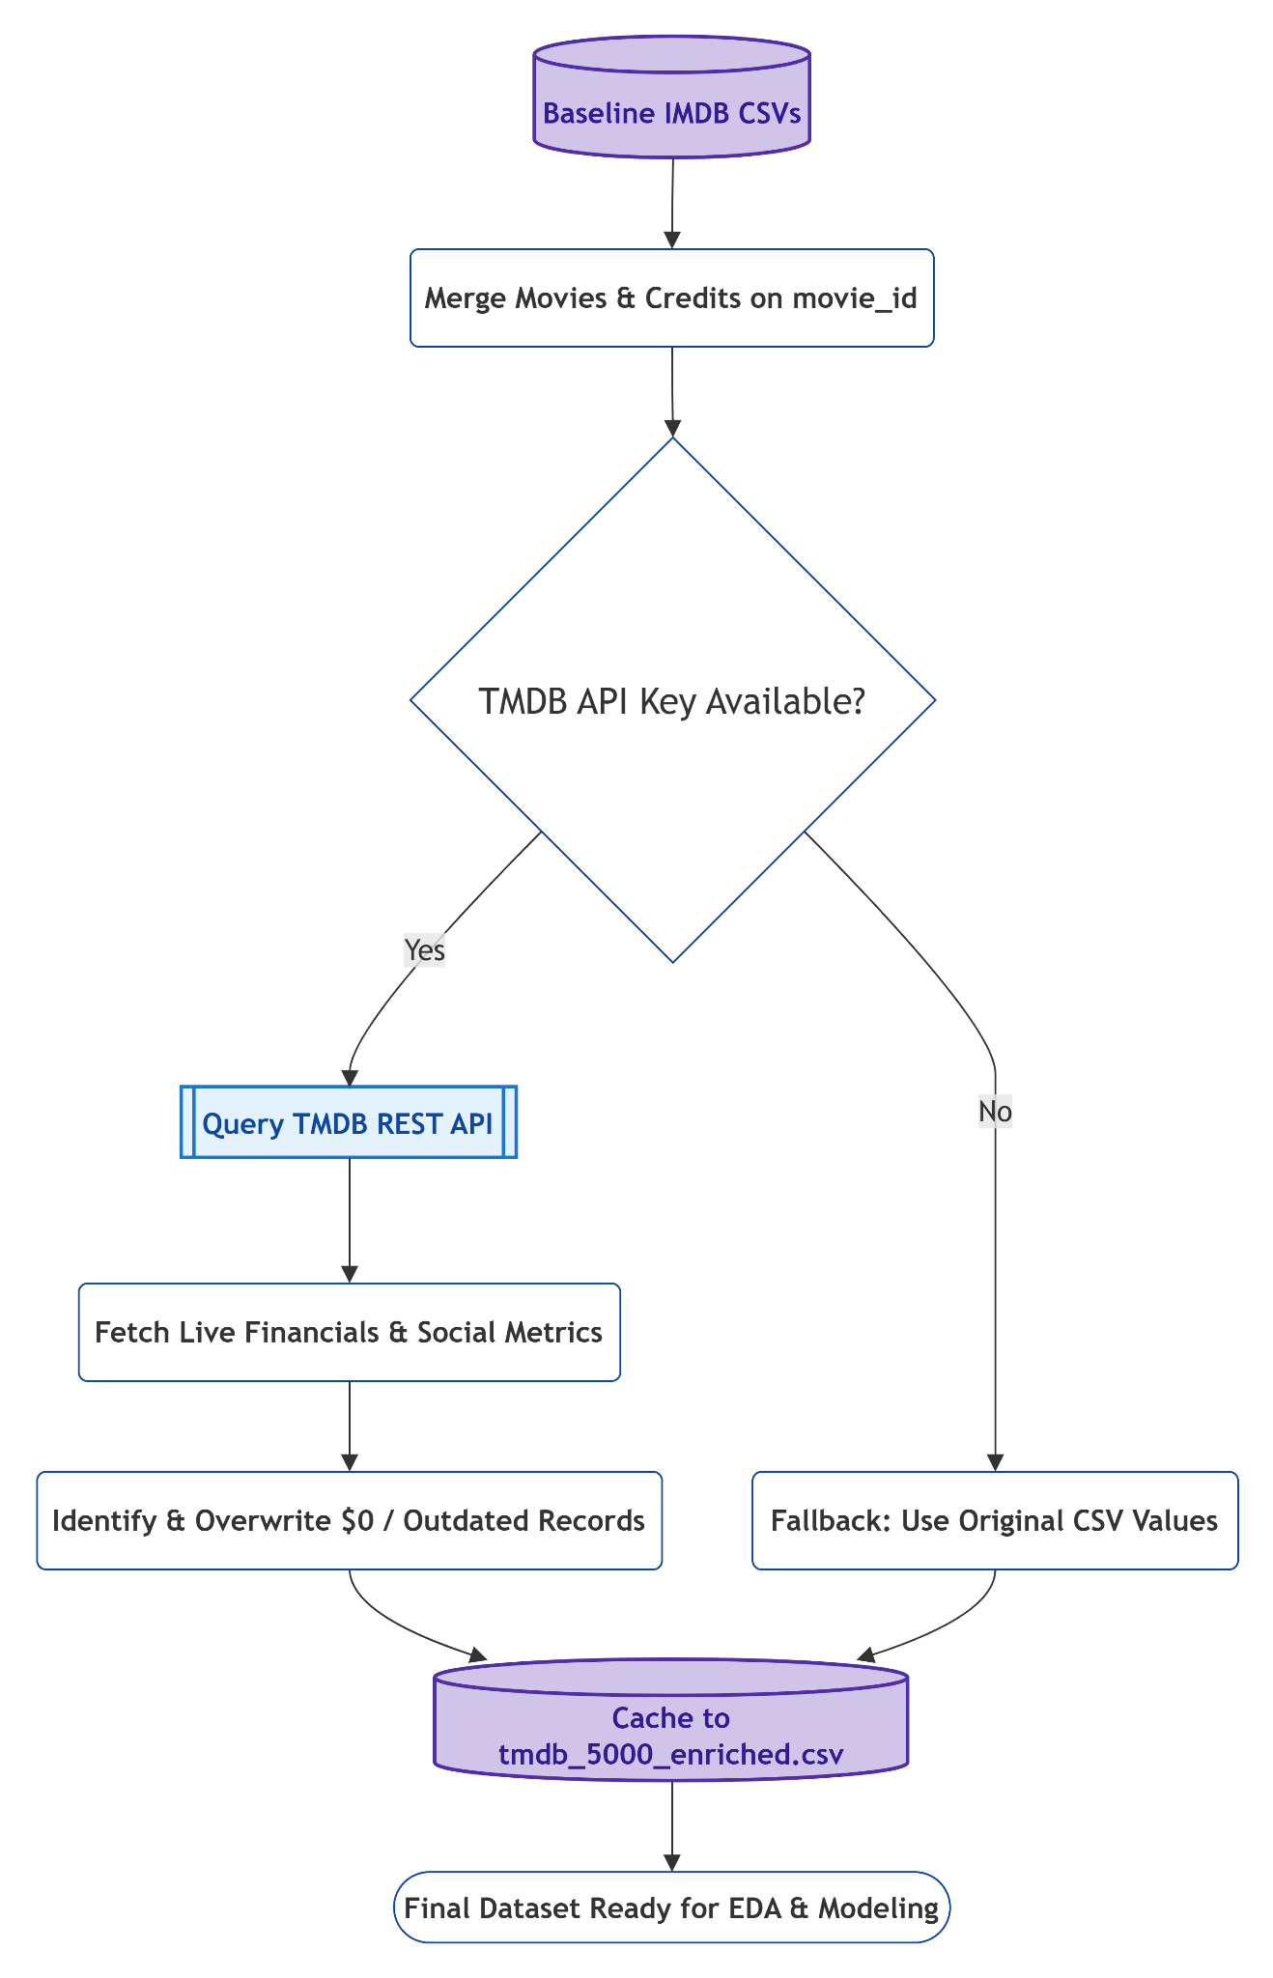
Data Collection & API Integration (BONUS)
Baseline Data Validation
Identified hundreds of missing or placeholder ($0) financial records in the initial IMDB Top 5000 dataset.
Live TMDB REST API Enrichment
Queried external JSON data endpoints using unique movie_id keys to fetch real-time social popularity, live vote averages, and updated box office revenues. This is shown in the flowchart.
MLOps & Caching
Engineered a caching function to save enriched data locally (tmdb_5000_enriched.csv). This prevents redundant network calls, bypasses API rate limits during model training, and ensures absolute reproducibility.

Slide 3
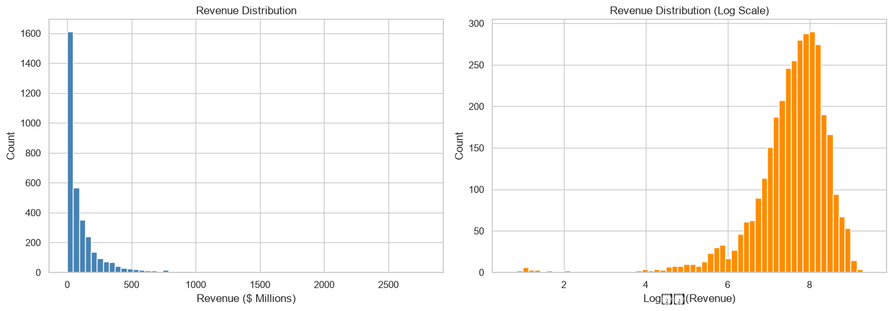
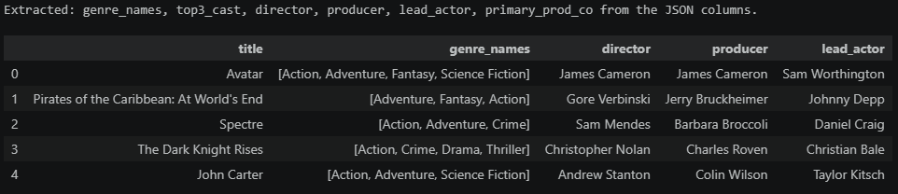
Exploratory Data Mining & Transformation
Distribution Skewness
Revenue follows a severe power-law distribution. Applied log1p transformations to target variables to stabilize variance.
Data Parsing
Extracted core entities (top-3 actors, directors, and producers) from complex nested JSON string arrays.
High-Fidelity Filtering
Filtered out unreleased titles, missing runtimes, and unrecoverable $0 financial rows to guarantee high-fidelity training data (3,229 pristine records).

Slide 4
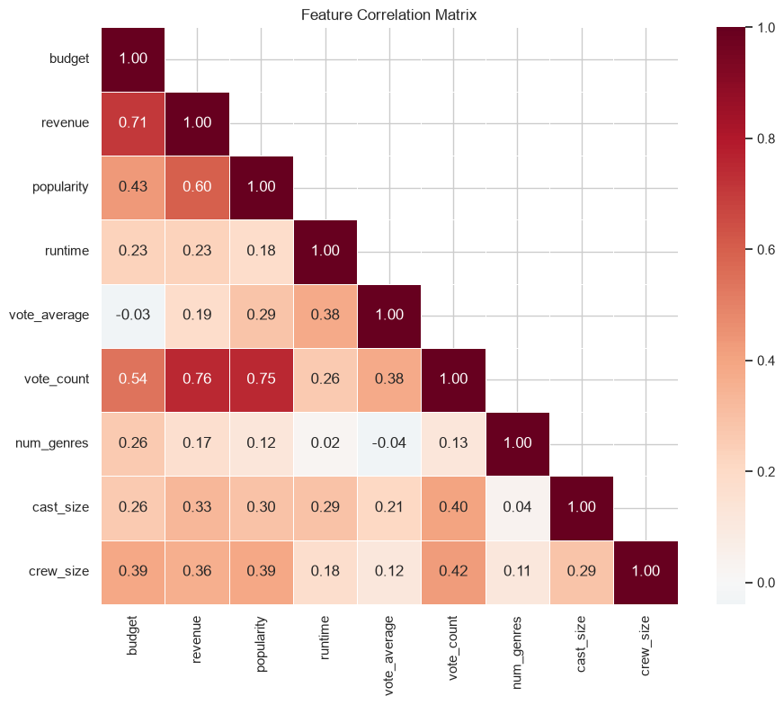
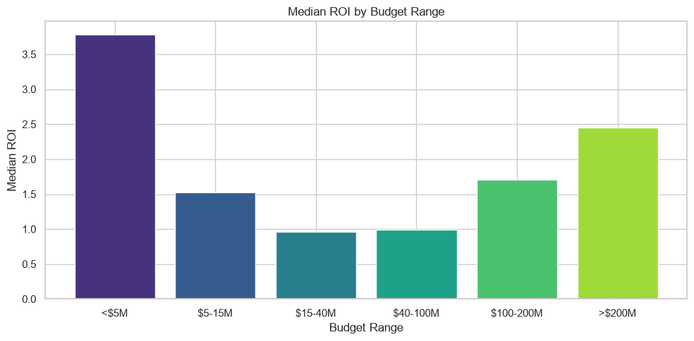
More on EDA
Core Revenue Predictors
Pre-release popularity and absolute budget scale exhibit the strongest positive correlations with box office revenue.
The ROI "U-Curve"
Return on Investment is highly non-linear. Micro-budgets (<$5M) yield the highest pure percentage returns (3.78x median), but the $40M–$100M range has the most optimal volume.
Temporal & Seasonal Peaks
Aggregating release dates confirmed massive consumer spending spikes in two distinct corridors: the Summer season (May–June) and the Holiday window (November–December).

Slide 5
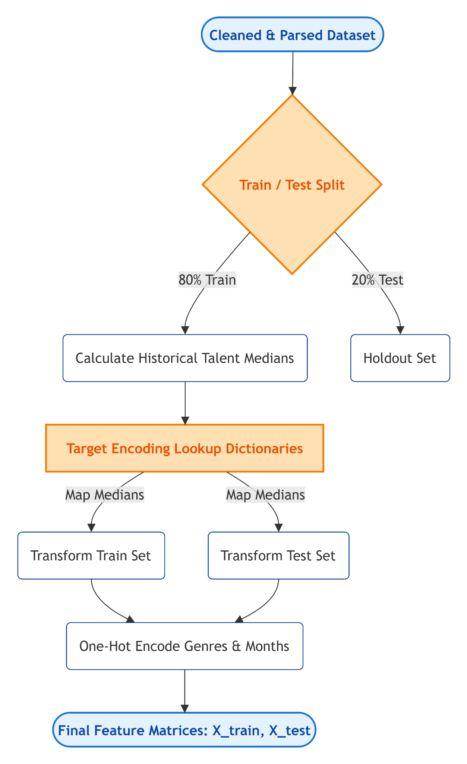
Feature Engineering: Target Encoding
High-Cardinality Transformation
Transformed sparse categorical variables (thousands of unique actors, directors, and producers) into dense numerical features by mapping them to their historical median box office revenues.
Strict Leakage Prevention
Computed all historical talent benchmarks strictly within the 80% training split. These lookup dictionaries were then mapped to the test set to guarantee zero data leakage from the future.
Frequency Thresholding
Enforced a minimum threshold of 3 appearances for a specific talent score to register. Rare or completely unseen talent automatically defaults to the global training median, preventing the model from memorizing single-hit outliers.

Slide 6
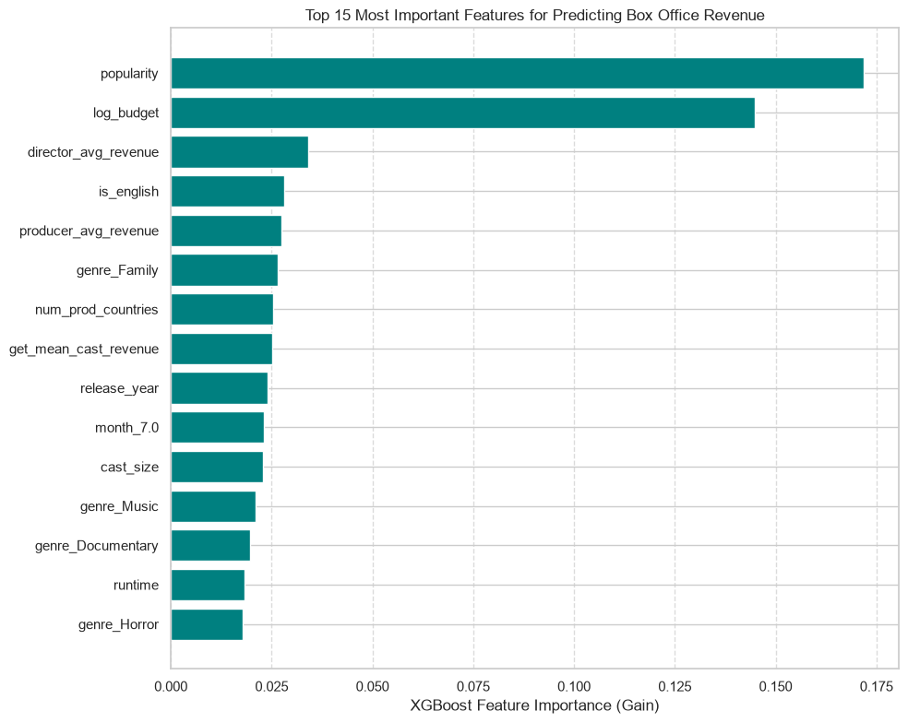
Modeling Strategy: XGBoost Regressor
Algorithm Choice
eXtreme Gradient Boosting (XGBoost) perfectly fulfills the 'prune only one algorithm' constraint.
Scale Invariance
Scale-invariant architecture handles massive box office outliers natively without requiring standard scaling.
Feature Interactions
Natively captures complex, non-linear feature interactions (e.g., diminishing returns of massive budgets).
Hyperparameter Tuning
Utilized GridSearchCV with 5-fold cross-validation. Constrained tree depth and applied L1/L2 regularization to prevent overfitting.

Slide 7
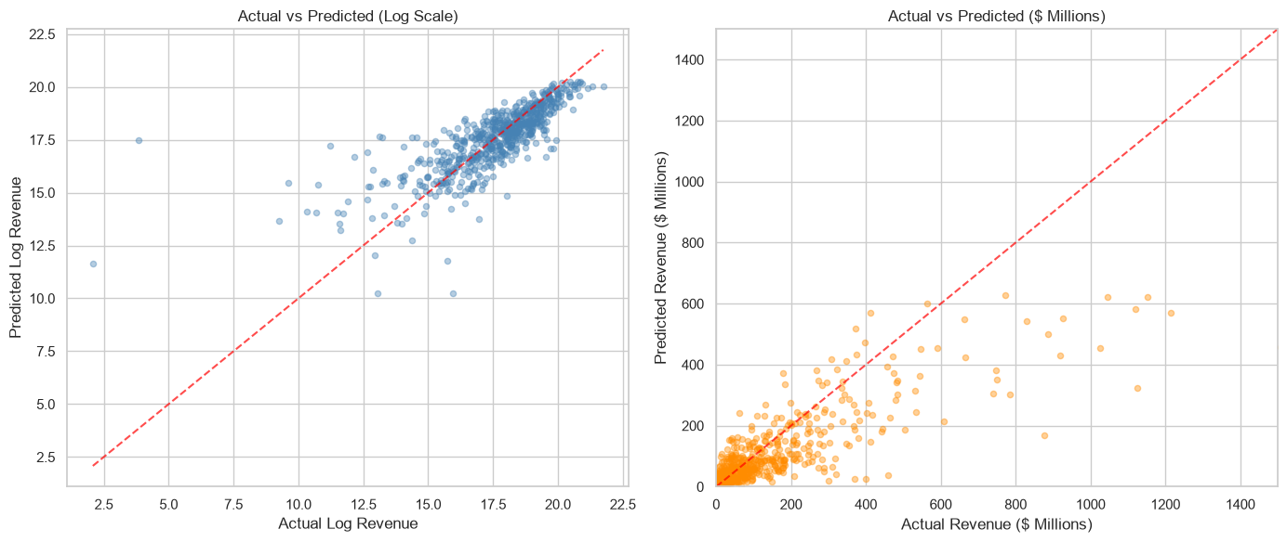
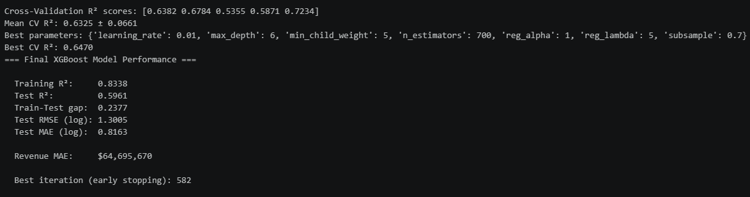
Model Evaluation & Serialization
Performance Metrics
Achieved strong R² performance of 0.8338 with optimized error margins across historical target distributions. The results confirm that the model is not overfitting or underfitting.
Balanced Fitting
1:1 Diagonal Tracking
Actual vs. Predicted plots confirm the model accurately tracks the 1:1 diagonal, capturing true variance without memorizing training noise.
Deployment Ready
movie_revenue_model.pkl
The finalized model, alongside required feature configurations and talent lookup dictionaries, was serialized via pickle for instant downstream deployment.

Slide 8
Answering Assignment Questions
What genre of film (thriller, adventure, romantic,...) should you create to make sure you make the most money?
Ans: Animation is the clear winner. It shows the highest median return (around $192.5M). It's also less crowded than heavily saturated genres like Drama or Comedy, making it a great market to target.
How should you spend to produce the movie to optimize ROI?
Ans: It depends on how you measure success. Analysis shows that for the best risk-adjusted returns, a budget between $40-100M is the sweet spot. If you just want the biggest possible absolute total gross, you have to spend big (over $100-200M). That said, micro-budgets (under $5M) actually give the highest percentage ROI (median 3.78x) simply because they are so cheap to make—they just won't pull in blockbuster-level cash.
Who are the top 3 actors you should hire to make sure you make the most money?
Ans: Based on my data analysis casting Rupert Grint, Daniel Radcliffe, and Emma Watson. The real, practical takeaway here is that casting leads with a built-in, dedicated fandom (or tying them to a massive IP) is one of the safest bets for high box office returns.
Any other impactful parameters you want to include
Ans: Budget and pre-release popularity scores are the biggest predictors of a movie's final scale. Beyond that, timing is everything like releasing during the summer or the holiday season gives a big bump. Runtimes hitting that 120-150 minute sweet spot, having a large crew, and filming in English for global distribution also consistently drive up revenue.
Which film director and film producer should you hire to make sure you make the most money?
Ans: Joss Whedon tops the list for directors (with a median revenue of $1.4B), and Christopher Meledandri is the top producer ($923M). The data shows that top producers tend to be much more consistent for hits across their careers compared to directors, whose box office numbers can vary wildly from film to film.

Slide 9
Thank you

